Slide 1
TEAM 6
Uncovering the Digital Trail
PRESENTERS:
2010030422_MANITEJA REDDY
2010030436_K.DIMPLE
2010030438_K.SIRISHA

Slide 2
INTRODUCTION:
Digital forensics is a branch of forensic science that focuses on identifying, acquiring, processing, analyzing, and reporting on data stored electronically.
Electronic evidence is a component of almost all criminal activities and digital forensics support is crucial for law enforcement investigations.
Electronic evidence can be collected from a wide array of sources, such as computers, smartphones, remote storage, unmanned aerial systems, shipborne equipment, and more.

Slide 3
ABSTRACT:
An electronic crime scene has the potential to hold massive amounts of data obtained from media devices. The primary goal of a cyber forensics investigator is to transform raw evidential data into useful data sets. Depending on the particular illegal activity, it is likely that a media device (i.e., Laptops, digital cameras, phones or hard drives) will vary in the size and amount of evidence. As an example, one criminal case may contain a small fraction of information or devices, another criminal case may contain a substantially larger amount of
data and multiple devices.
The main goal of our project is to extract data from the electronic devices, process it and analyzing it.

Slide 4
HARDWARE REQUIREMENTS: WINDOWS SOFTWARE REQUIREMENTS: OSForensics
R
E
Q
U
I
R
E
M
E
N
T
S

Slide 5
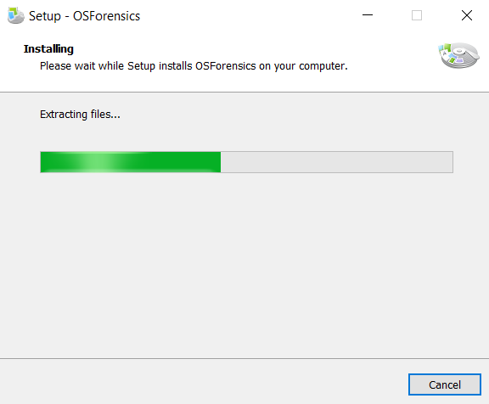
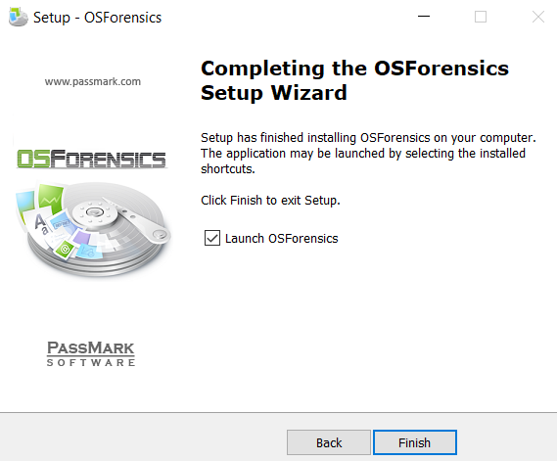
IMPLEMENTATION:
OSForensics:
OS Forensics lets you extract forensics evidence fron computers quickly with high performance file searches and indexing, allows you to search for files many times faster than the search functionality in Windows
Collecting data from computers.
Manage your investigation
Extract evidence from computers quickly
Identify suspicious files and activity
Group the files and find all the documents/images.

Slide 6
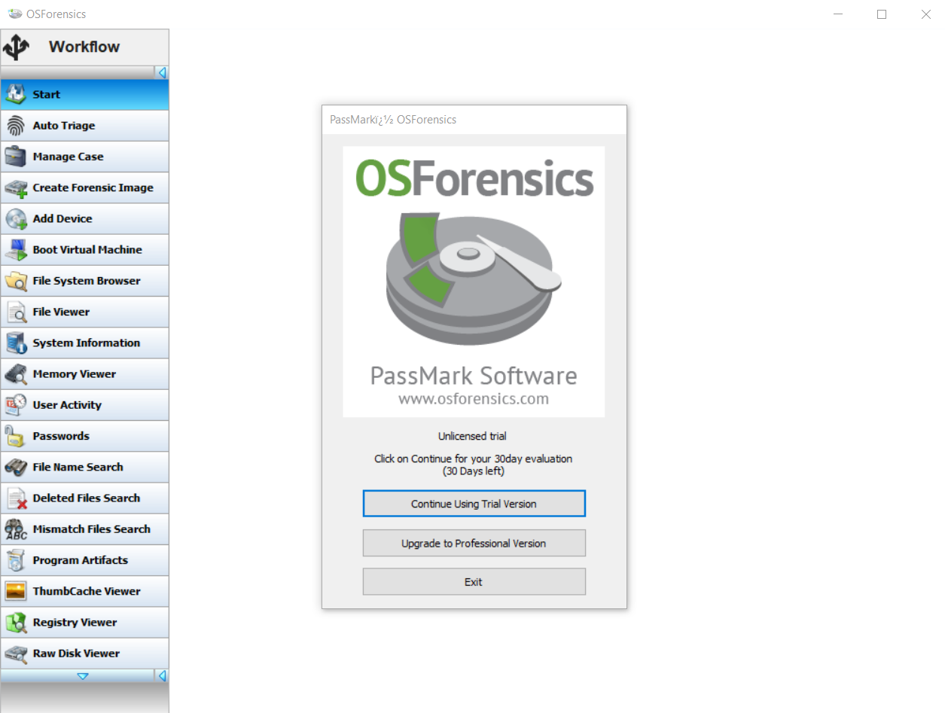
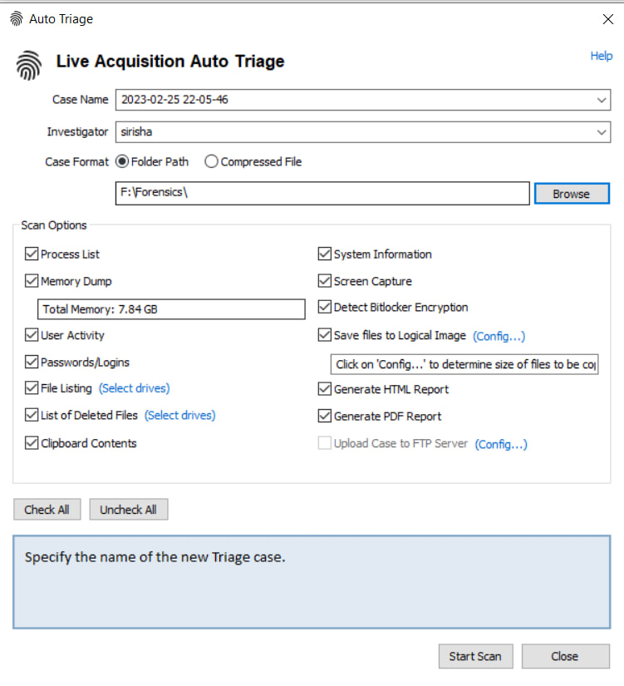
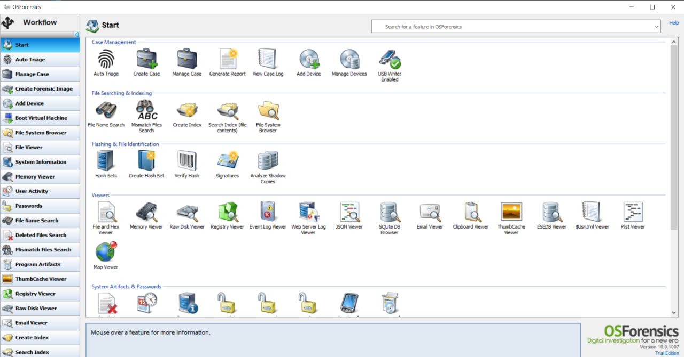
Tools in digital forensics
AUTO TRIAGE TOOL

Slide 7
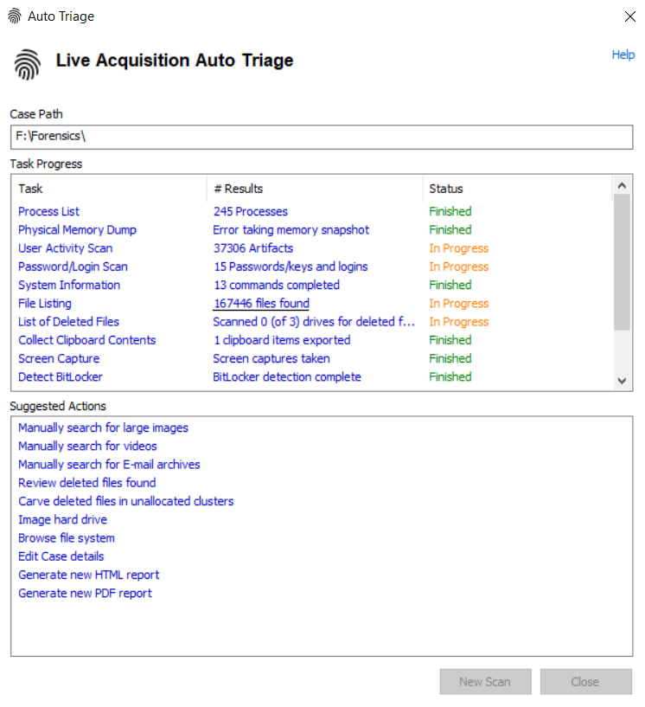
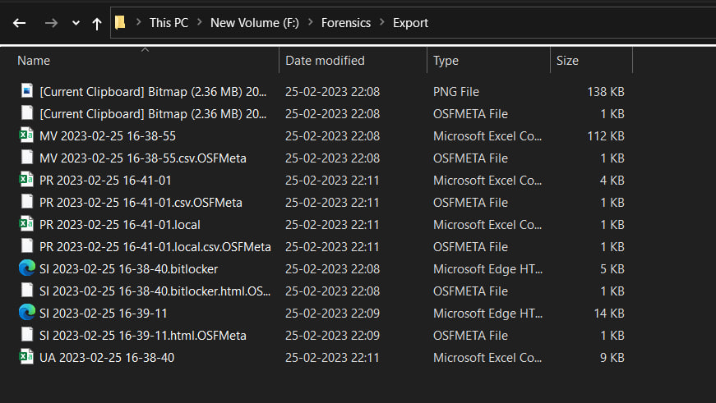
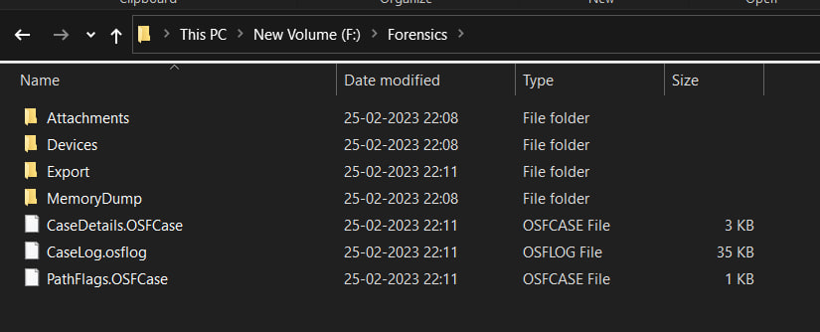
DATA ANALYSIS
DATA FROM OS

Slide 8
THANK YOU

